Slide 1

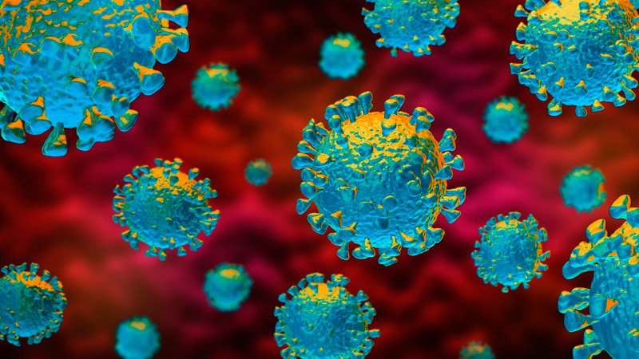
Module 05
Sample Collection & Referral

Slide 2
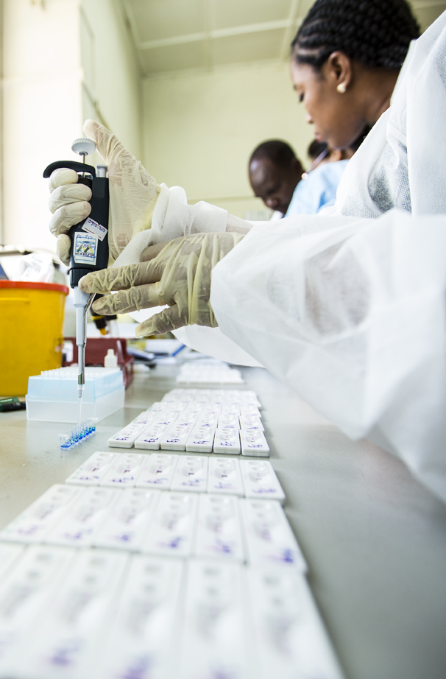
Learning Objectives
M.05
At the end of this module you will be able to:
  Appropriately collect respiratory samples from patients with possible COVID-19
  Explain how proper protocols ensure high-quality sample integrity
  Refer appropriate samples for PCR

Slide 3
Introduction to Sample Collection
Collecting good samples is first step in determining diagnosis and treatment.
  Critical for rapid-diagnosis of COVID-19
Collecting high-quality samples using proper protocols:
  Is critical in the testing and diagnosis of COVID-19
  Includes: proper collection and proper sample handling
  Increases the likelihood of a usable result (for any diagnostic test)
  Reduces likelihood of generating false-negative test results (in turn, protecting communities from potential transmission)
Responsible cadre: trained clinician or nurses, lab techs, and other frontline healthcare workers properly trained to safely collect, handle, and transport patient samples

Slide 4
General Guidelines
Read, understand, and adhere strictly to all applicable biosafety measures for collecting, handling, and managing samples for COVID-19 testing
  Using established sample collection procedures helps yield high quality samples
Timing:
  Collect the sample as soon as possible, regardless symptom onset timing
  Test the sample as soon as possible after collection
Correct sample collection technique is critical; otherwise, a HCW might cause injury to patient
HCW should always practice standard and transmission-based precautions

Slide 5
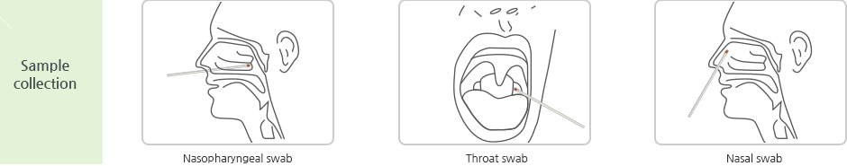
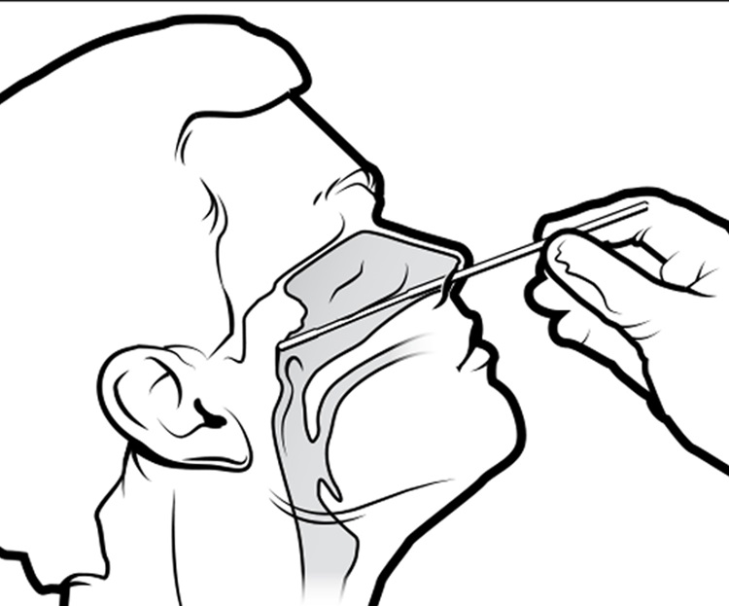
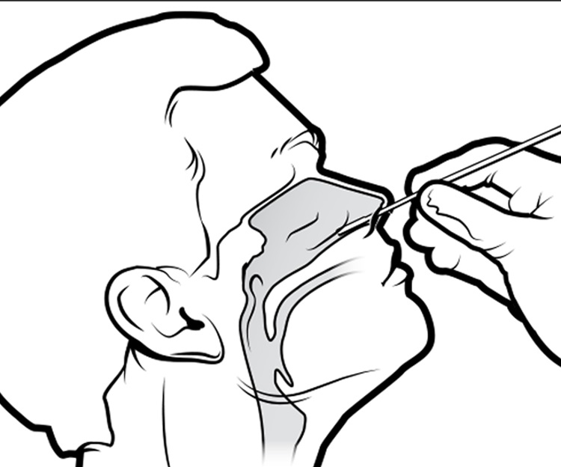
Types of Sample Collection
Nasopharyngeal sample
Nasal swab (both nares)
  While Nasopharyngeal Swabs are preferred for antigen RDTs, Nasal Swabs are under consideration
  Nasal Swabs are the approved sample collection method for device-based antigen testing
  Note: Sample Collection steps in the following slides represent general guidance. Please see manufacturer-specific instructions for detailed sample type and technique.
Nasopharyngeal swab
Nasal swab
Source: Image from the CDC’s interim guidelines for collecting, handling, and testing clinical specimens from persons for COVID-19

Slide 6
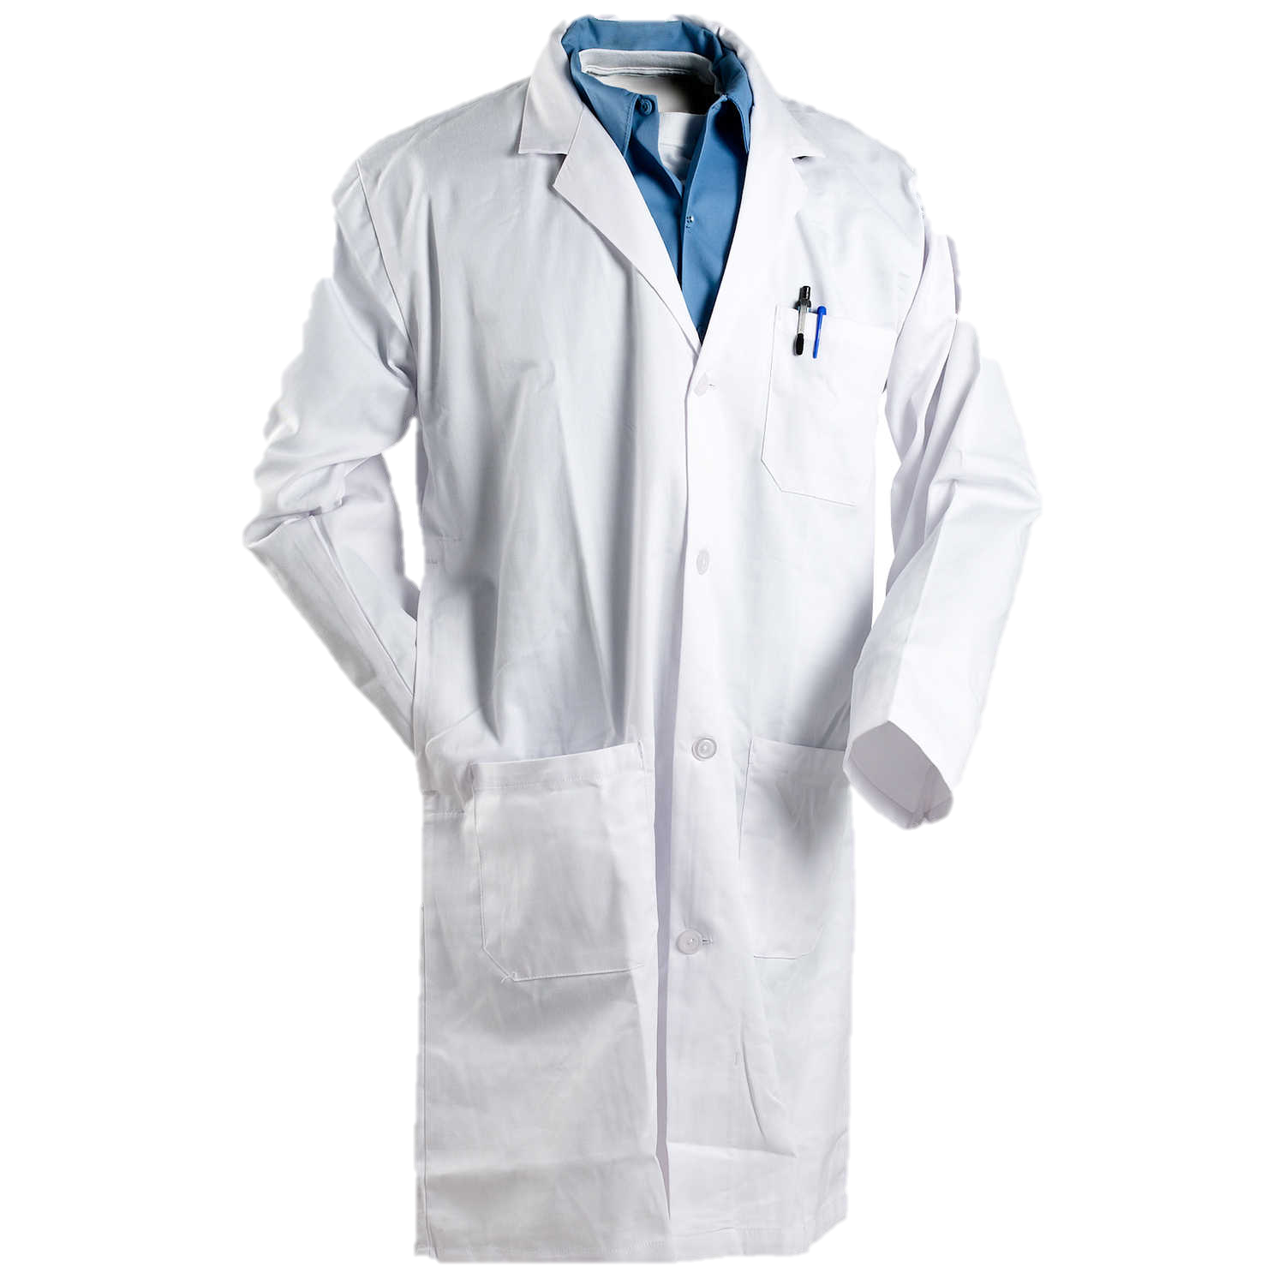
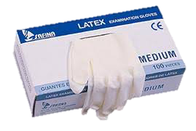
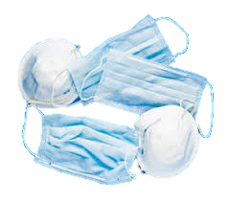
Before Sample Collection
Before collecting samples, a healthcare worker should:
  Do hand hygiene, and put on appropriate PPE
    Gown (long sleeve that cover arms to the end of the wrists )
    Mask / N95 respirator
    Face shield or goggles
    Clean, disposable gloves
  Gather all necessary sample-collection supplies (see next slide)
    Assemble within reach at sample collection workstation
  Safely transport the patient to well ventilated procedure room, and shut the door
    Only HCW who are essential for patient care and procedure support are permitted in the room
    Visitors should not be present for sample collection
    Introduce yourself to the patient, discuss the procedure, and patient permission to proceed
Before
During
After
HCW should always practice standard and transmission-based precautions
Notes:
Participants can use Materials - Sample Guidelines for reference
Participants can also use guides from Module 04 for reference:
Materials - Hand Wash Instructions
Materials – PPE
Materials – Workstation Prep

Slide 7
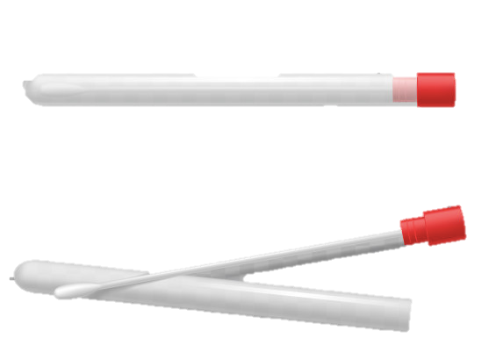
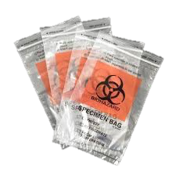
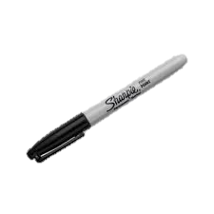
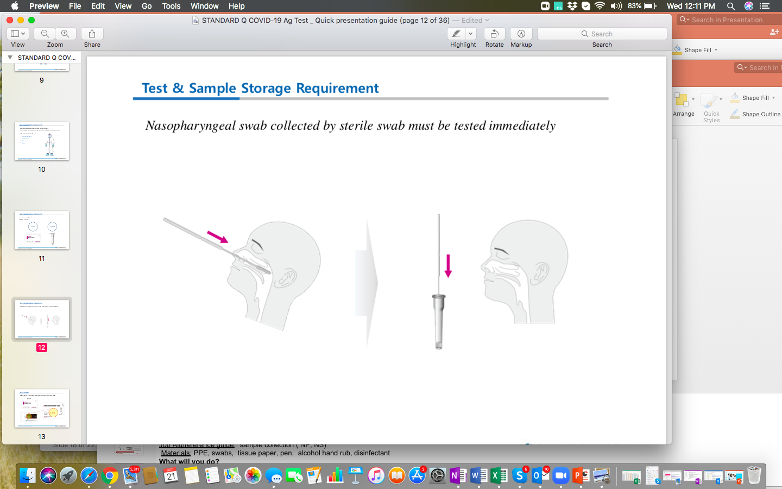
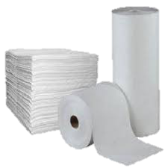
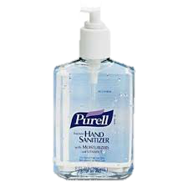
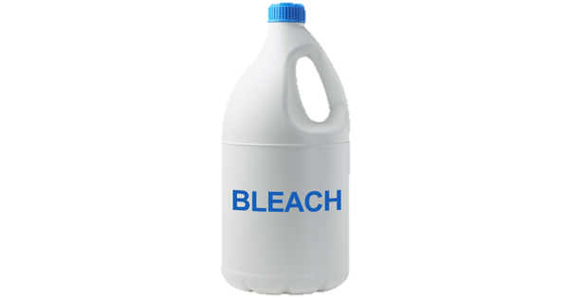
Necessary Supplies
Before
  Gather all necessary sample-collection supplies
    Sterile swab ( individually wrapped)
    Leak proof Biohazard bags and waste bins
    Permanent marker and pen
    Primary receptacle (e.g. extraction buffer tube or viral transport media)
    Test request form
    Tissue paper or paper towel
    PPE
    Alcohol based hand rub (e.g. 70% alcohol) or soap and water
    Disinfectant (e.g. 10% bleach or ethanol)
During
After
HCW should always practice standard and transmission-based precautions
Notes:
Participants can use Materials - Sample Guidelines for reference

Slide 8
Before Sample Collection (cont.)
Before collecting samples, a healthcare worker should:
  Do all necessary labeling (ensure legible, complete, accurate)
    Antigen Testing Logbook / Register
      General patient information,
      Type of sample,
      Date of collection, and
      Contact info (of tester)
    Extraction Buffer tube
      Patient name,
      ID number,
      Date, and
      Type of sample
    Device-based data entry (if applicable)
Before
During
After
All information should match
HCW should always practice standard and transmission-based precautions
Notes:
Participants can use Materials - Sample Guidelines for reference
Activity Option: Practice Exercise (15 min)
Fill register and lab requisition form
What will you need?
Job Aid: Country specific sample collection register and lab requisition form
Materials: VTM tube and pen
What will you do?
Divide into groups
Work by 2s – one will serve as HCW and the other as patient.
Collect mock information
Complete the register and lab requisition form
Label the VTM tube using the 4 key information

Slide 9
Activity A: Labeling / Data Practice
Purpose: Practice appropriate pre-collection labeling / data entry
Instructions:
  Divide into pairs (practicing COVID-19 safety precautions)
  One person will pretend to be the patient and supply mock patient information
  Other partner will:
    Complete Antigen Testing Logbook / Register
    Complete Test Requisition form
    Label the extraction buffer tube using the 4 key information
    (if applicable) Enter patient information into the device
  Switch roles and repeat
Activity Time: 15 min (5-7 min each)
Notes:
EXPLAIN: Next, you will practice filling the register and lab requisition forms
Note: PRACTICE COVID-19 safety precautions, including:
MAINTAIN distance of 2-meter (minimum) during partner discussions
RETAIN the same partner throughout the training, to reduce contact
WEAR face masks
INVITE participants to DIVIDE into pairs.
EXPLAIN the instructions:
One partner will PRETEND to be the patient and SUPPLY mock patient information
The other partner will:
COMPLETE Antigen Testing Logbook / Register
COMPLETE Test requisition form
LABEL the extraction buffer tube using the 4 key information
(if applicable) ENTER patient information into the POC device
SWITCH ROLES and REPEAT
ALLOW 15 minutes total (5-7 minutes each).
WALK AROUND to OBSERVE and ASSIST where necessary.

Slide 10
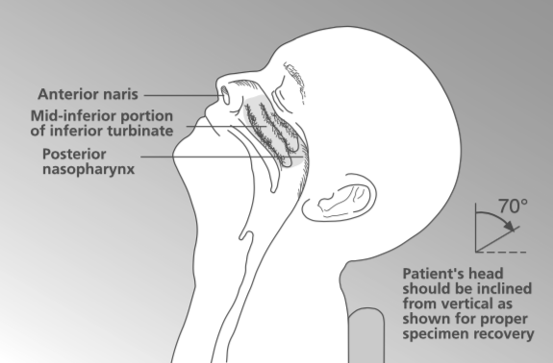
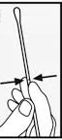
During Sample Collection
During sample collection, a healthcare worker should:
  Have the patient use a tissue to blow their nose
    Gently check for mucus / obstructions that could alter test results
    Clean the nasal passage before a swab is taken
  Open the swab container and remove the swab
    Do NOT touch the tip to any surface or lay it down
  Hold the swab with fingers placed on the score line (see next)
  With the patient seated, if possible, tilt the patient’s head back 70 degrees
    Support the back of the head with the non-dominant hand
    Note: for infants and younger children, use supine position
      Children often find sampling from the respiratory tract very distressing and need to be reassured. They may also need to be restrained during the sampling process.
Before
During
After
HCW should always practice standard and transmission-based precautions
Notes:
Participants can use Materials - Sample Guidelines for reference

Slide 11

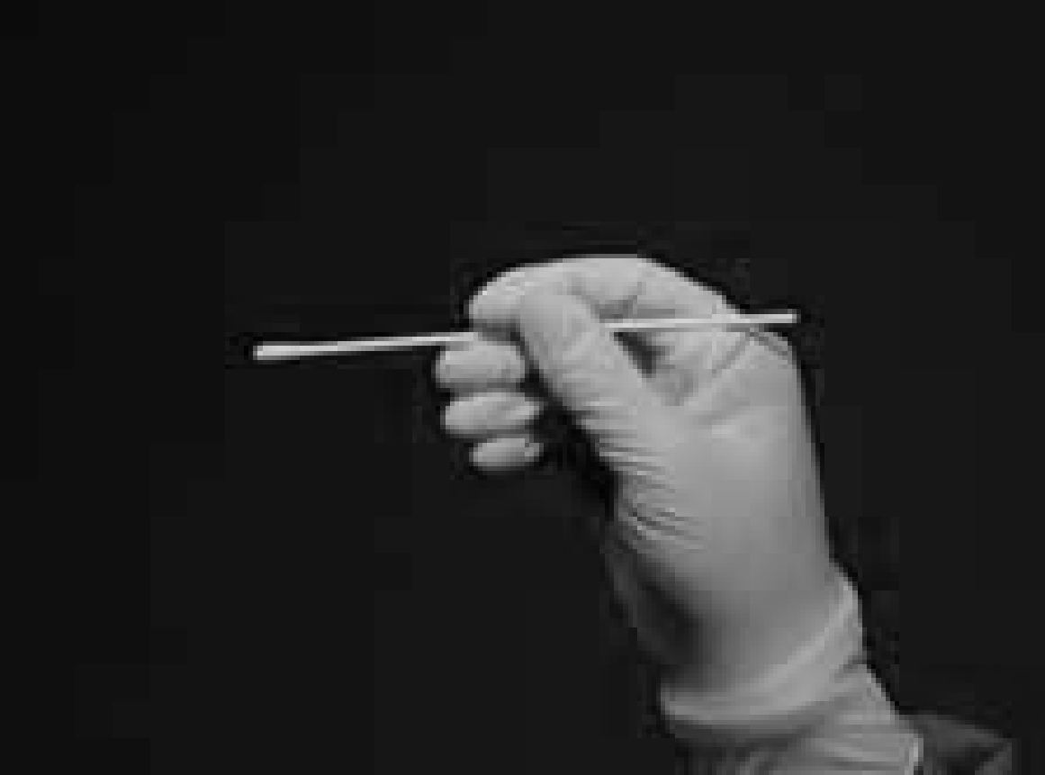
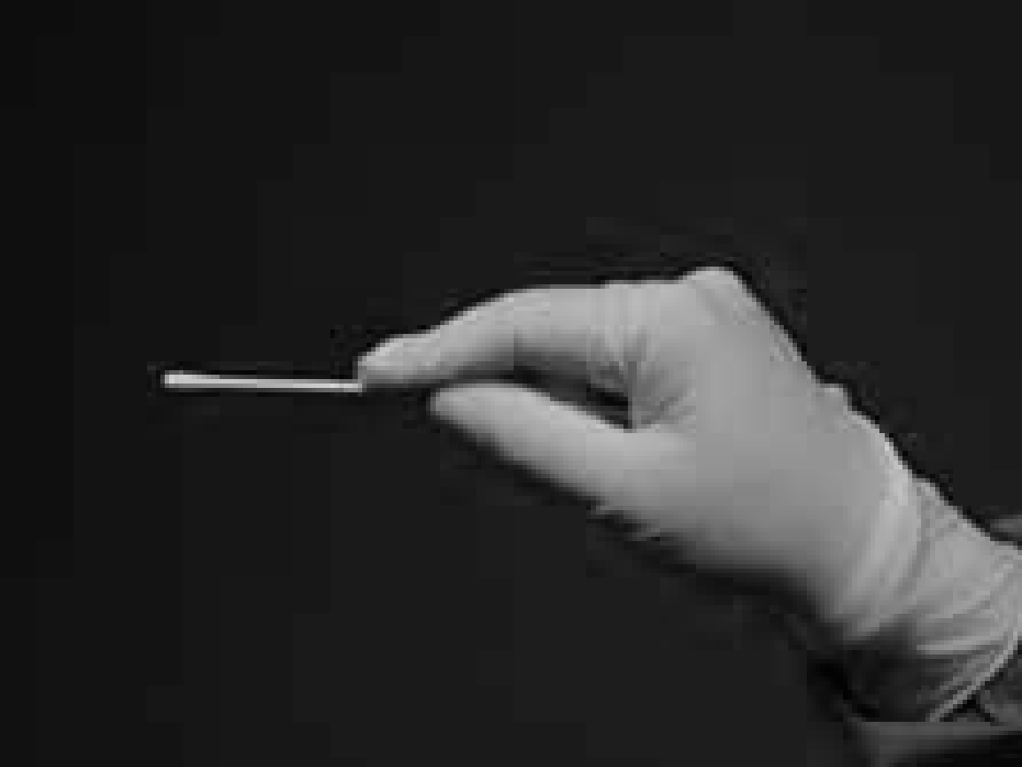
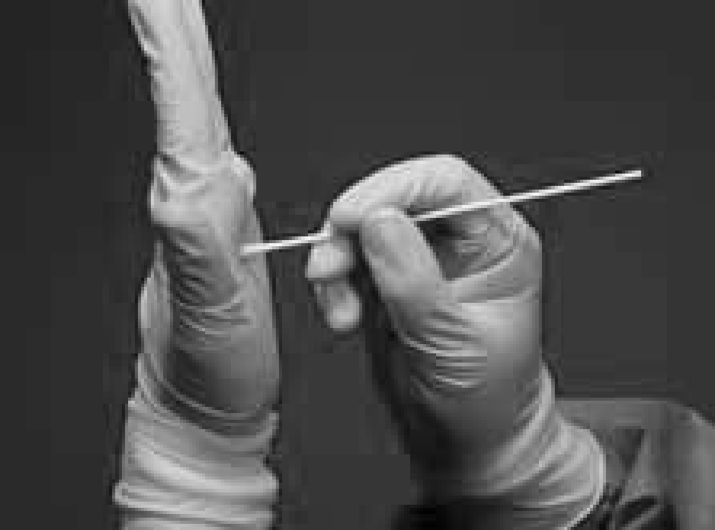
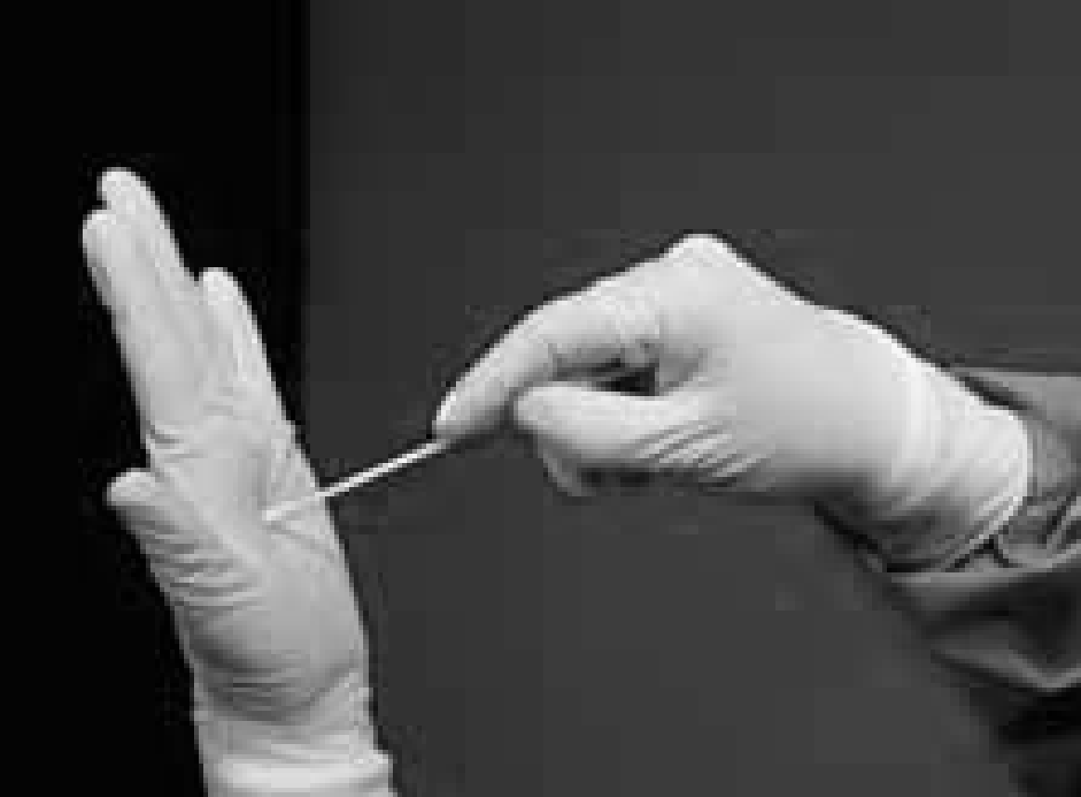
Proper Swab Holding
  Hold the swab with fingers placed on the score line
x
Before
During
After
Swab held correctly
Swab held incorrectly
Correct can slide out of the way
Incorrect can injure the client
HCW should always practice standard and transmission-based precautions
Source: photos adopted from Zambia Revised COVID-19 Health workers training, March 2020
Notes:
Participants can use Materials - Sample Guidelines for reference

Slide 12
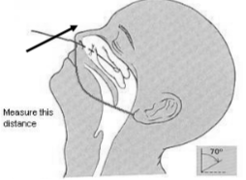
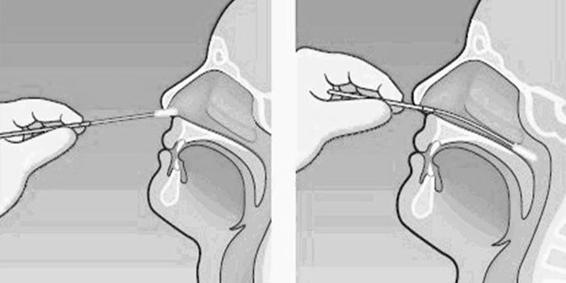
Nasopharyngeal Sample Collection
  Swab the patient’s nasopharynx
    Straighten the passage from the front of the nose to the nasopharynx to make insertion of the swab easier
    Gently insert swab into the nostril, parallel to the palate (not upwards)
    How far:
      Until resistance is encountered, or
      Measure: distance from the corner of the nose to the front of the ear - insert the shaft ONLY half this length
      In adults, this distance is usually about 4 cm. In children this distance is less.
    Gently rub and roll the swab, 3-4 times against the nasopharyngeal wall
Before
During
After
    Leave swab in place for several seconds to absorb secretions
    Slowly remove the swab while rotating it
    Avoid sample contamination: do not touch the swab tip to anything except the inside of the nostril
HCW should always practice standard and transmission-based precautions
Notes:
Participants can use Materials - Sample Guidelines for reference

Slide 13
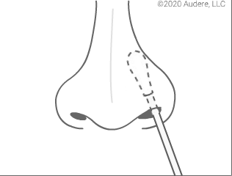
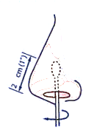
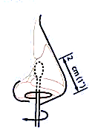
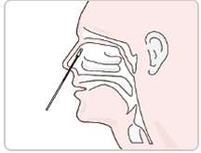
Anterior Nares Sample Collection
  Swab the patient’s anterior nares (nasal swab)
    While gently rotating the swab, gently insert swab less than one inch into the first nostril
      How Far: Until resistance is met at turbinates (a small structure inside the nose)
    Rotate the swab several times against the nasal wall
    Leave in place for three (3) seconds
    Withdraw slowly with a rotating motion
    Repeat in the other nostril with the same swab – test requires both nostrils
    To avoid sample contamination, do not touch the swab tip to anything other than the inside of the nostril
Before
During
After
Note: For NS self- collection, provide clear instruction to patient and careful oversight during procedure. Label as self-collected.
    Note: Use swabs provided in test kit or separately provided by lab specifically for COVID-19 antigen testing (do not use cotton swabs)
HCW should always practice standard and transmission-based precautions
Notes:
Participants can use Materials - Sample Guidelines for reference

Slide 14
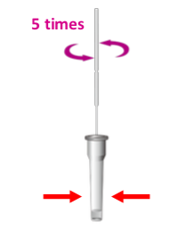
During Sample Collection (Cont.)
During sample collection, a healthcare worker should:
  Process the sample in the appropriate solution
    Sample processing = mixing the sample with the appropriate solution before using it in the test kit / device
    Sample processing should be done in accordance with test-specific IFUs
    Note: Sample processing and testing should be done as soon as possible after collection
Before
During
After
HCW should always practice standard and transmission-based precautions
Notes:
Participants can use Materials - Sample Guidelines for reference
Activity Option: Practice Exercise (45 min)
Properly and safely perform respiratory sample collection
What will you need?
Job Aid: sample collection ( NP, OP,NS)
Materials: PPE, VTM tube, swabs, tissue paper, pen, alcohol hand rub, disinfectant, tongue depressor
What will you do?
Observe skilled Clinician demonstrate respiratory sample collection
Divide into groups
Work by 2s – one will serve as HCW and the other as patient.
Put on PPE and observe transmission-based precaution
With supervision, perform sample collection
Practice sample collection
Discussions on challenges and feedback

Slide 15
Activity B: Sample Collection Practice
Purpose: Practice appropriate sample collection procedures
Instructions:
  Divide into pairs (practicing COVID-19 safety precautions)
  One person will pretend to be the patient and consent to being tested
  Other partner will:
    Put on PPE and observe transmission-based precaution
    With supervision, perform sample collection
  Switch roles and repeat
Activity Time: 20 min (10 min each)
Notes:
EXPLAIN: Next, you will practice collecting respiratory samples
Note: PRACTICE COVID-19 safety precautions, including:
MAINTAIN distance of 2-meter (minimum) during partner discussions
RETAIN the same partner throughout the training, to reduce contact
WEAR face masks
INVITE participants to DIVIDE into pairs.
EXPLAIN the instructions:
One partner will PRETEND to be the patient and be tested
The other partner will:
PUT ON PPE and OBSERVE transmission-based precaution
With supervision, PERFORM sample collection
SWITCH ROLES and REPEAT
ALLOW 20 minutes (10 minutes each).
WALK AROUND to OBSERVE and ASSIST where necessary.
ASK: What was difficult about this exercise?
FACILITATE brainstorm and discussion. INVITE responses from women and men equally.
ASK: What do you need (resources, practice) to prepare for this task at your own health facility?
FACILITATE brainstorm and discussion. INVITE responses from women and men equally.
ALLOW 10 minutes for discussion.

Slide 16
After Sample Collection (1)
After collecting samples, a healthcare worker should:
  Test the sample as soon as possible after collection
  If not possible to test the sample immediately, follow test specific IFU recommendations for storage
    Nasopharyngeal samples may be stored and tested at room temperature for 1-2 hours
    The extracted nasal swab sample must be used within 5 hours when stored at room temperature
      Extracted nasal samples may be frozen at -80°C and tested up to 5 days after freezing
  Note: Samples and extraction buffer must be at room temperature before testing
  According to your country algorithm, if a second sample is to be collected for NAAT molecular testing, ensure appropriate materials and reagents (e.g. viral transport medium) are available at the workstation
Before
During
After
HCW should always practice standard and transmission-based precautions
Notes:
Participants can use Materials - Sample Guidelines for reference

Slide 17
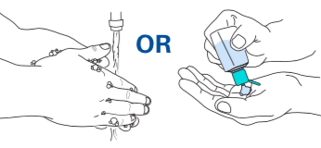
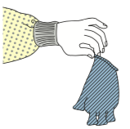
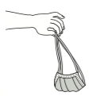
After Sample Collection (2)
After collecting samples, a healthcare worker should:
  Properly remove PPE, and do hand hygiene
  Discard all use materials (gloves, face mask, and all contaminated materials) to biohazard bin
    Repeat hand hygiene if contaminated
  Clean and disinfect the procedure room surfaces (using appropriate disinfectants and recommended contact times)
Before
During
After
HCW should always practice standard and transmission-based precautions
Notes:
Participants can use Materials - Sample Guidelines for reference

Slide 18
OFF-Site Contingency
If lab-testing is not available on-site, a healthcare worker should:
  Pack for transport immediately after collection
    Package samples individually in a plastic zipper bag following the:
      Triple Packaging System (see next slide)
    Place samples inside the cooler-box
      In the upright position
      On tube rack
      Well secured
    Keep the cooler-box lid closed
  Transport at room temperature immediately after packing
    Transport within the time recommended by manufacturer
    Alert the designated testing site before sending the sample(s)
HCW should always practice standard and transmission-based precautions
Notes:
Participants can use Materials - Sample Guidelines for reference

Slide 19
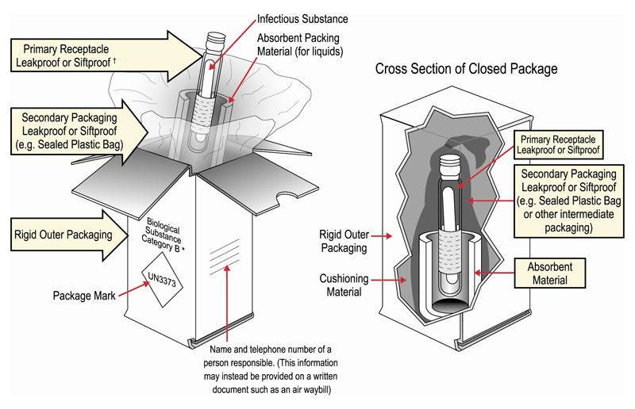
Triple Packaging System
Triple packaging for category B biological substances (COVID-19 samples)
  Protects the sample from breaking or leaking in transit
  Prevents contamination of the courier and environment if breakage/leakage occurs
Made of 3 layers:
  Primary receptacle
    Placed in the secondary packaging
    Includes additional absorbent material
  Secondary
    Watertight and made from an cooler box with lid
  Outer packaging
    Dry box to protect the secondary packaging
Note: If no commercial packages available, improvise with common items found at facility that adhere to triple packaging principles
ª If you ship samples to WHO reference laboratories or collaborating centres outside the country or ship samples by air, you must ensure compliance with all international standards (IATA) for Biological Substances (Category B)
Notes:
Participants can use Materials – Triple Packaging for reference

Slide 20
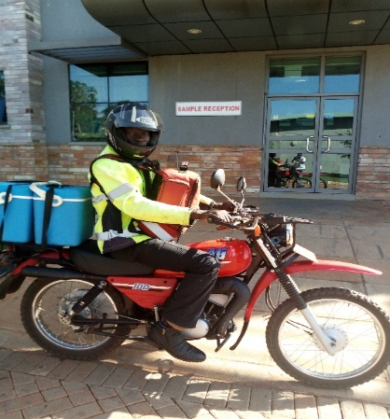
Covid-19 Sample Referral
National Sample Transport/Referral System (Hub system) will used for sample referral
The second samples (for PCR) will be transported to the testing laboratory through the existing hub system this will be either by Motor Bike or UNHLS/MOH Cars
Respective districts should work with their “HUB CORDINATORS” to ensure the samples are transported timely to the testing laboratories

Slide 21
Summary
Two samples should be collected
    Sample for Ag testing
    For PCR testing (in transport media)
Proper documentation must be maintained at the facility
  Results of the RDT must be recorded in on the CIF accompaning the sample for RDT
  Record of RDT results and PCR in the daily Covid-19 register
  Chain of custody forms be completed for sample tracking

Slide 22
Questions

