Slide 1
VL Monitoring updates
Dr Miriam Murungi

Slide 2
Trends in VL Monitoring for COP17(OCT 17- Sep 2018)
-Aug18 had the highest # of samples
December and January lowest
Need to get at least 100,000 samples in Sep’18 before

Slide 3
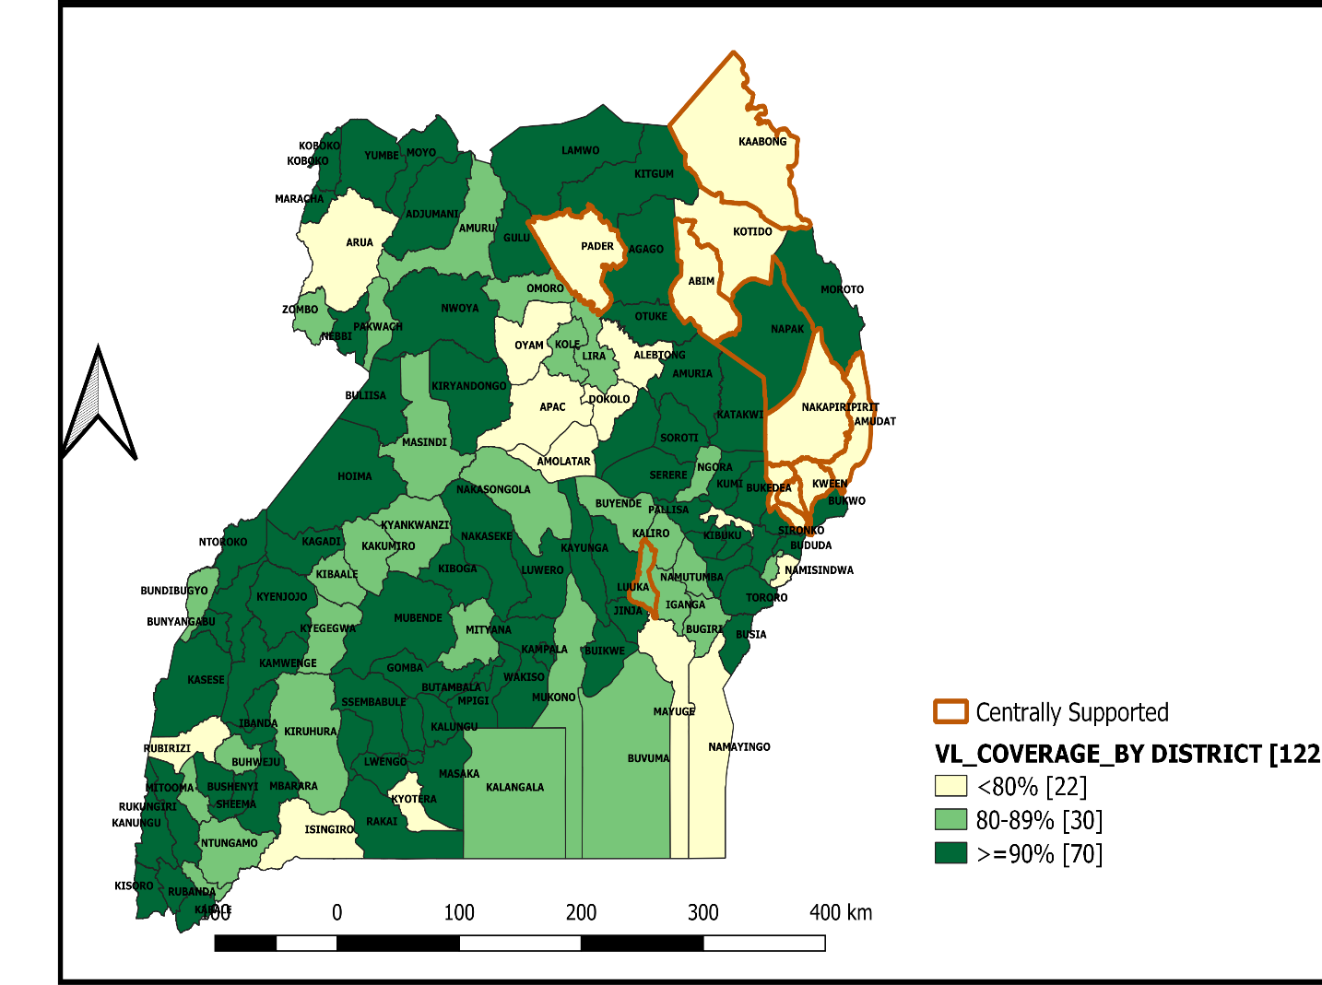
VIRAL LOAD COVERAGE August 17-July18
90% viral load coverage in 70 districts country wide.
22 districts still have poor coverage
Viral Load Coverage heavily reliant on IP presence in the region.
Children, adolescents , pregnant and breastfeeding women accessing 6 monthly viral load tests.
Other adults receive 1 VL test per year.

Slide 4
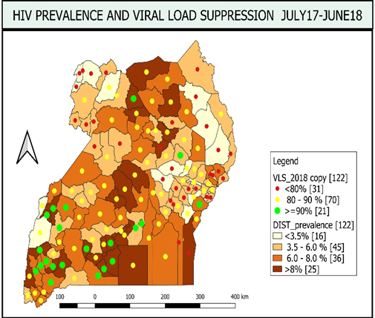
Viral Suppression Rates
Geographical Variations In Viral Suppression;
-Low VLS noted in West Nile, North East and East Central Districts
Children and adolescents have much lower suppression rates than adults
Young men 20-24 years have much lower suppression rates than their female counterparts.
Notes:
Program data shows Low suppression Rates in Karamoja unlike the UPHIA estimates
Consistent with Estimates in other regions

Slide 5
Increased Plasma to DBS ratio
Proportion of Plasma samples :DBS now 1:1
Dried blood spot (DBS) specimens provide a way to improve the coverage and reach of viral load testing where:
-hard to reach remote and rural areas where preparation and transport of plasma specimens is limited by cold-chain requirements
- lack of staff trained to perform venipuncture and plasma separation.

Slide 6
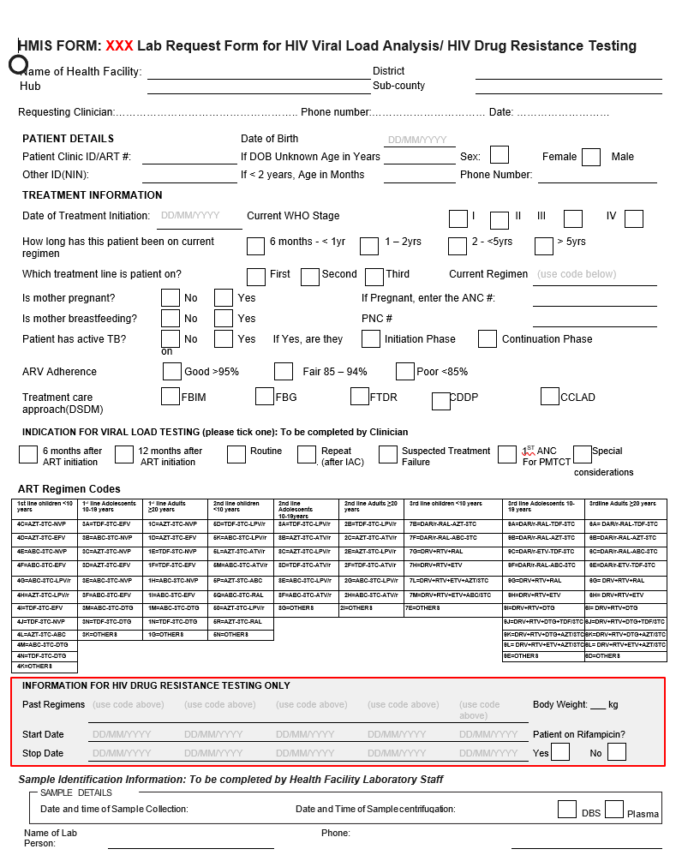
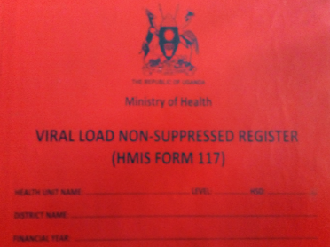
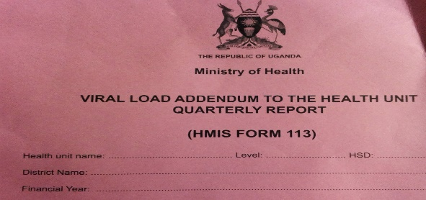
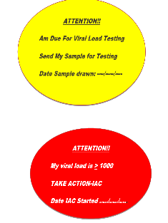
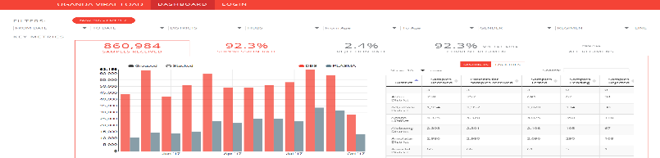
VL M&E TOOLS
VENUE | TOOL
LABORATORY | VL TEST REQUEST FORM, LABORATORY REGISTER FOR VIRAL LOAD & CD4, LABORATORY STAMP (PILOT), LIMS at CPHL
CLINIC | PATIENT HIV CARE CARD, ART Register, CLIENT APPOINTMENT REGISTER, NON-SUPPRESSION REGISTER), RED & YELLOW FILE STICKERS, UgandaEMR (openMRS)
REPORTING | QUARTERLY VL SUMMARY REPORT HMIS 113 (PILOT),DHIS2, VIRAL LOAD DASHBOARD

Slide 7
Next steps
IPs to plan for regional and facility based trainings
CQI projects on non-suppressed cascade
Upcoming PEPFAR reporting, need to clean data for DATIM reporting on missing data elements
LabCOP regional meeting 15th-17th October 2018
-Document best practices

Slide 8


